Slide 1
Chapter 4 Number Theory and Cryptography
Section 2
Primes and GCD

Slide 2
Outline
Primes
Conjectures and Open Problems About Primes
GCD and LCM

Slide 3
Primes
Prime. (质数)
  A positive integer p greater than 1 is called Prime (a prime number) if the only positive factors (division) of p are 1 and p
Composite. (合数)
  A positive integer greater than 1 that is not prime is called composite. (a composite number)
Fundamental theorem of arithmetic. (算术基本定理)
  Every positive integer greater than 1 can be written uniquely as a prime or as the product of two or more primes when the prime factors are written in order of non-decreasing size. (Euclid)

Slide 4
Primes
Example.
  Prime factorizations of integers
    100 = 2∙2∙5∙5 = 2²∙5²
    641 = 641
    999 = 3∙3∙3∙37 = 3³∙37
    1024 = 2∙2∙2∙2∙2∙2∙2∙2∙2∙2 = 2¹⁰

Slide 5
Primes
Theorem.
  If n is a composite integer, then n has a prime division less than or equal to √n
  Proof.
  As n is composite, n has a factor 1<a<n, and thus n=ab
  It’s easy to show that a ≤ √n or b ≤ √n by contraposition
  Thus n has a divisor not exceeding √n
  This divisor is either prime or by the Euclid’s fundamental theorem of arithmetic, has a prime divisor less than itself, and thus a prime divisor less than √n

Slide 6
Primes
Example.
  Show that 101 is prime
    The only primes not exceeding √101 are 2, 3, 5, 7
    As 101 is not divisible by 2, 3, 5, 7, it follows that 101 is prime

Slide 7
Primes
Procedure for Prime Factorization.
  Begin by diving n by successive primes, starting with 2
  If n has a prime factor, we would find a prime factor not exceeding √n
  If no prime factor is found, then n is prime
  Otherwise, if a prime factor p is found, continue by factoring n/p
  Note that n/p has no prime factors less than p
  If n/p has no prime factor greater than or equal to p and not exceeding its square root, then it is prime
  Otherwise, continue by factoring n/(pq)
  Continue until factorization has been reduced to a prime

Slide 8
Primes
Example.
  Find the prime factorization of 7007
  Solution.
  Start with 2, 3, 5, and then 7, 7007/7=1001
  Then, divide 1001 by successive primes, beginning with 7, and find 1001/7=143
  Continue by dividing 143 by successive primes, starting with 7, and find 143/11=13
  As 13 is prime, the procedure stops
  7007=7∙7 ∙11 ∙13=7² ∙11 ∙13

Slide 9
Primes
Theorem.
  There are infinitely many primes
  Proof. (by contradiction)
  Assume that there are only finitely many primes, p₁, p₂, …, p_{n}. Let Q = p₁p₂…p_{n}+1
  By the fundamental theorem of arithmetic: Q is prime or else it can be written as the product of two or more primes
  However, none of the primes p_{j} divides Q , for if p_{j}|Q, then p_{j} divides Q-p₁ p₂ … p_{n} =1
  Hence, there is a prime not in the list p₁, p₂, …, p_{n}
  This prime is either Q, if it is prime, or a prime factor for Q
  This is a contradiction as we assumed that we have listed all the primes

Slide 10
Primes
Remark.
  As there are infinite number of primes, there is an ongoing quest to find larger and larger prime numbers
Mersenne Primes.
  The largest prime known has been an integer of special form 2^{p}-1 where p is also prime
  Furthermore, it is not currently possible to test numbers not of this or certain other special forms anywhere near as quickly as determine whether they are prime
  Example.
    2²-1=3, 2³-1=7, 2⁵-1=31 are Mersenne primes while 2¹¹-1=2047 is not a Mersenne prime (2047=23 ∙ 89)

Slide 11
Primes
  Mersenne (French, 17th AD.) claims that 2^{p}-1 is prime for p=2, 3, 5, 7, 13, 17, 19, 31, 67, 127, 257 but is composite for all other primes less than 257.
  It took over 300 years to determine it is wrong 5 times
    For p=67, p=257, 2^{p}-1 is not prime
    But p=61, p=87, and p=107, 2^{p}-1 is prime
  The largest Mersenne prime known (as of early 2006) is 2^{30,402,457}-1, a number with over nine million digits

Slide 12
Primes
The prime number theorem (素数定理)
  The ratio of the number of primes not exceeding x and x/lnx approaches 1 as x grows without bound
  The number of primes not exceeding x can be approximated by x/lnx
  For estimating: The probability that a randomly selected positive integer less than n is prime are approximately (n/lnn)/n=1/lnn
    Example: The odds that an integer near 10¹⁰⁰⁰ is prime are approximately 1/ln10¹⁰⁰⁰, approximately 1/2300

Slide 13
Primes
Goldbach’s conjecture (哥德巴赫猜想, 1742)
  Every even integer n, n>2, is the sum of two primes
  4=2+2, 6=3+3, 8=5+3, 10=7+3, 12=7+5, …
  As of 2006, the conjecture has been checked for all positive even integers up to 2⋅10¹⁷
Twin prime conjecture (孪生素数猜想, 1900)
  Twin primes are primes that differ by 2. There are infinitely many twin primes

Slide 14
Greatest Common Divisors
Definition. (GCD, 最大公因数)
  Let a and b be integers, not both zero. The largest integer d such that d|a and d|b is called the greatest common divisor of a and b, often denoted as gcd(a, b)
  Example.
    gcd(10, 17) = 1, gcd(10, 21) = 1, gcd(10, 24) = 2
    gcd(a, 0) = a for any non-zero integer a
  The integers a and b are relative prime (互素) if their GCD is 1
  The integers a₁, a₂, …, a_{n} are pairwise relatively prime (两两互素) if gcd(a_{i}, a_{j}) = 1 whenever 1 ≤ i < j ≤ n

Slide 15
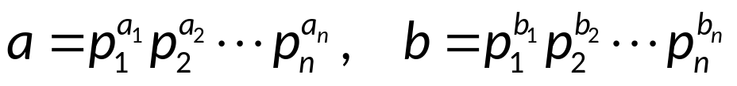
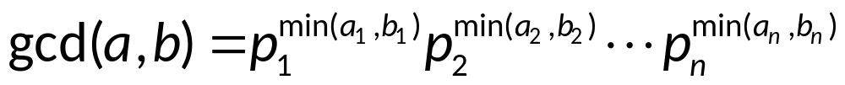
Greatest Common Divisors
Finding GCD
  Positive integers a and b factorized to
  Then the greatest common divisor of a and b
  Example.
    a = 120, b = 500
    120 = 2³⋅3⋅5, 500 = 2²⋅5³
    gcd(a, b) = 2²⋅3⁰⋅5¹ = 20

Slide 16
Greatest Common Divisors
The Euclidean Algorithm. (欧几里德辗转相除法)
  The Euclidean Algorithm finds the greatest common divisor of two integers a and b.
  For example, if we want to find gcd(287, 91), we divide 287 by 91:
  287 = 91⋅3 + 14
  We know that for integers a, b and c, if a|b and a|c, then a|(b + c)
  Therefore, any divisor of 287 and 91 must also be a divisor of 287 - 91⋅3 = 14.
  Consequently, gcd(287, 91) = gcd(14, 91).

Slide 17
Greatest Common Divisors
The Euclidean Algorithm.
  In the next step, we divide 91 by 14:
  91 = 14⋅6 + 7
  This means that gcd(14, 91) = gcd(14, 7)
  So we divide 14 by 7:
  14 = 7⋅2 + 0
  We find that 7|14, and thus gcd(14, 7) = 7
    or gcd(7, 14) = gcd(7, 0) = 7
  Therefore, gcd(287, 91) = 7
  The Euclidean algorithm in pseudocode will be discussed in next section.

Slide 18
Least Common Multiple
Definition. (LCM, 最小公倍数)
  Least common multiples of the positive integers a and b is the smallest positive integer that is divisible by both a and b, denoted as lcm(a, b)
Finding LCM
  Let
  Then the least common multiple of a and b
  Example.
    a = 120, b = 500
    120 = 2³⋅3⋅5, 500 = 2²⋅5³
    lcm(a, b) = 2³⋅3¹⋅5³ = 3000

Slide 19
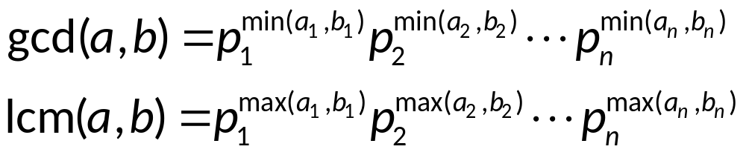
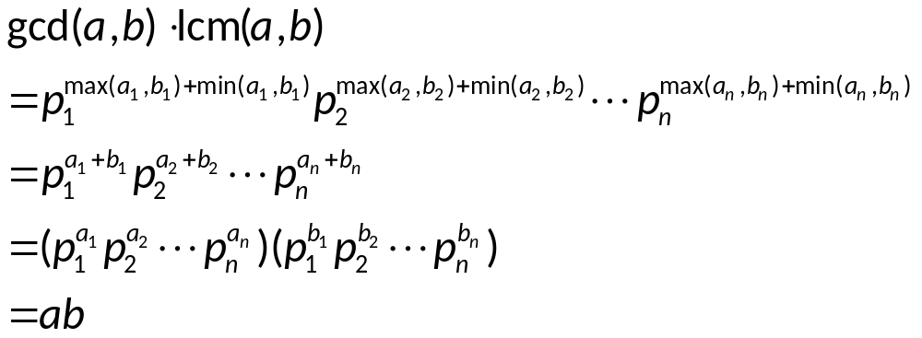
Least Common Multiple
Theorem.
  Let a and b be positive integers, then ab=gcd(a, b)∙lcm(a, b)
  Proof.
  Let
  Then
  So

Slide 20
Assignment
Exercises after 3.5: No. 17, 32 (Ver.6)
Exercises after 4.3: No. 21, 50 (Ver.7)

